Slide 1
Support Vector Machine (SVM)

Slide 2
Introduction
Support Vector Machine (SVM) is one of the most popular Supervised Learning algorithms, which is used for Classification as well as Regression problems.
However, primarily, it is used for Classification problems in Machine Learning.

Slide 3
Introduction
SVM chooses the extreme points/vectors that help in creating the hyper-plane.
These extreme cases are called as support vectors, and hence algorithm is termed as Support Vector Machine.

Slide 4
Basic Goal
To create the best line or decision boundary that can segregate n-dimensional space into classes so that we can easily put the new data point in the correct category in the future.
This best decision boundary is called a hyperplane.

Slide 5


Slide 6
Types of SVM
SVM can be of two types:
Linear SVM
Linear SVM is used for linearly separable data, which means if a dataset can be classified into two classes by using a single straight line, then such data is termed as linearly separable data, and classifier is used called as Linear SVM classifier.
Non-linear SVM
Non-Linear SVM is used for non-linearly separated data, which means if a dataset cannot be classified by using a straight line, then such data is termed as non-linear data and classifier used is called as Non-linear SVM classifier.

Slide 7
Hyper-plane
There can be multiple lines/decision boundaries to segregate the classes in n-dimensional space, but we need to find out the best decision boundary that helps to classify the data points. This best boundary is known as the hyper-plane of SVM.
The dimensions of the hyper-plane depend on the features present in the dataset, which means if there are 2 features (as shown in image), then hyper-plane will be a straight line. And if there are 3 features, then hyper-plane will be a 2-dimension plane. We always create a hyper-plane that has a maximum margin, which means the maximum distance between the data points.

Slide 8
Support Vectors
The data points or vectors that are the closest to the hyper-plane and which affect the position of the hyper-plane are termed as Support Vector.
Since these vectors support the hyper-plane, hence called a Support vector.

Slide 9
Working of SVM
An SVM model is basically a representation of different classes in a hyperplane in multidimensional space.
The hyperplane will be generated in an iterative manner by SVM so that the error can be minimized.
The goal is to divide the datasets into classes to find a maximum marginal hyperplane (MMH).

Slide 10
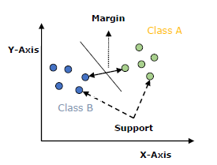

Slide 11
Concept of SVM
The followings are important concepts in SVM −
Support Vectors
Hyper-plane
Margin
Support Vectors − Data points that are closest to the hyper-plane is called support vectors. Separating line will be defined with the help of these data points.
Hyperplane − As we can see in the above diagram, it is a decision plane or space which is divided between a set of objects having different classes.
Margin − It may be defined as the gap between two lines on the closet data points of different classes. It can be calculated as the perpendicular distance from the line to the support vectors. Large margin is considered as a good margin and small margin is considered as a bad margin.
The main goal of SVM is to divide the datasets into classes to find a maximum marginal hyper-plane (MMH) and it can be done in the following two steps −
First, SVM will generate hyper-planes iteratively that segregates the classes in best way.
Then, it will choose the hyper-plane that separates the classes correctly.

Slide 12
Concept of SVM
The followings are important concepts in SVM −
Support Vectors
Hyper-plane
Margin
Support Vectors − Data points that are closest to the hyper-plane is called support vectors. Separating line will be defined with the help of these data points.
Hyperplane − As we can see in the above diagram, it is a decision plane or space which is divided between a set of objects having different classes.
Margin − It may be defined as the gap between two lines on the closet data points of different classes. It can be calculated as the perpendicular distance from the line to the support vectors. Large margin is considered as a good margin and small margin is considered as a bad margin.
The main goal of SVM is to divide the datasets into classes to find a maximum marginal hyper-plane (MMH) and it can be done in the following two steps −
First, SVM will generate hyper-planes iteratively that segregates the classes in best way.
Then, it will choose the hyper-plane that separates the classes correctly.

Slide 13
Concept of SVM
Hence, the SVM algorithm helps to find the best line or decision boundary; this best boundary or region is called as a hyperplane.
SVM algorithm finds the closest point of the lines from both the classes. These points are called support vectors.
The distance between the vectors and the hyperplane is called as margin. And the goal of SVM is to maximize this margin.
The hyperplane with maximum margin is called the optimal hyperplane.

Slide 14
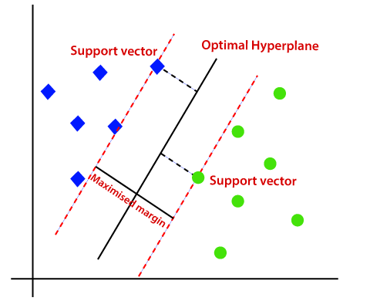

Slide 15
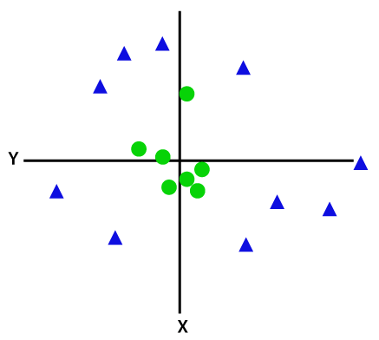
Working Non-Linear SVM
If data is linearly arranged, then we can separate it by using a straight line, but for non-linear data, we cannot draw a single straight line. Consider the below image:

Slide 16
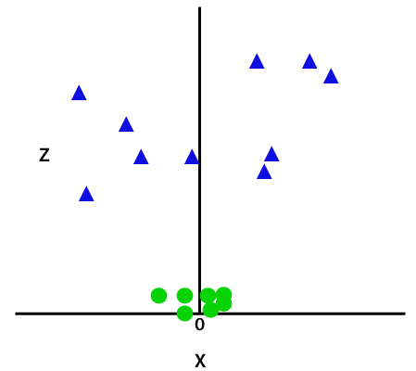
Concept of SVM
So to separate these data points, we need to add one more dimension.
For linear data, we have used two dimensions x and y, so for non-linear data, we will add a third dimension z.
It can be calculated as:
z=x² +y²
By adding the third dimension, the sample space will become as below image:

Slide 17
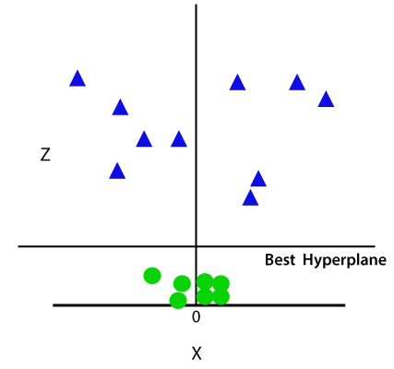
Concept of SVM
So now, SVM will divide the datasets into classes in the following way. Consider the below image:
Since we are in 3-d Space, hence it is looking like a plane parallel to the x-axis.
If we convert it in 2d space with z=1, then it will become as:

Slide 18
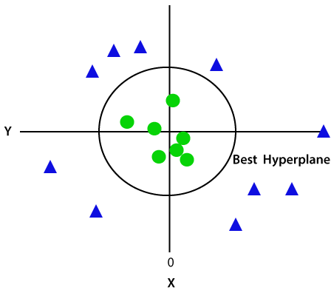
Concept of SVM
Since we are in 3-d Space, hence it is looking like a plane parallel to the x-axis.
If we convert it in 2d space with z=1, then it will become as:
Hence we get a circumference of radius 1 in case of non-linear data.

Slide 19
SVM Pros/Cons
Pros of SVM
SVM classifiers offers great accuracy and work well with high dimensional space. SVM classifiers basically use a subset of training points hence in result uses very less memory.
Cons of SVM classifiers
They have high training time hence in practice not suitable for large datasets. Another disadvantage is that SVM classifiers do not work well with overlapping classes.

Slide 20
How Does Identify Right Hyperplane
Scenario-1 Here we have 3 hyperplanes (A, B, and C). Now identify the right hyperplane for classify the stars and circles.
You need to remember the thumb rule to identify the right hyperplane: select the hyperplane that segregates the two classes better.
In this scenario hyperplane B perform their job excellently.
A
B
C

Slide 21
How Does Identify Right Hyperplane
Scenario-2 Here we have 3 hyperplanes (A, B, and C)and all are segregating the classes well. Now how can we identify the right Hyperplane.
Here, maximizing the distance between nearest data points and Hyperplane will help us to decide the right Hyperplane.
In above picture margins of Hyperplane C is more than the others. So C has selected as the best Hyperplane.
A
B
C

Slide 22
How Does Identify Right Hyperplane
Scenario-3 Here we have 2 hyperplanes (A, and B). Use the rules as discussed in previous section to identify the right Hyperplane
SVM selects the Hyperplane which classifies the classes accurately prior to maximizing the margins.
Hyperplane B has a classification error and A has classified all accurately. Therefore right Hyperplane is A.
B
A

Slide 23
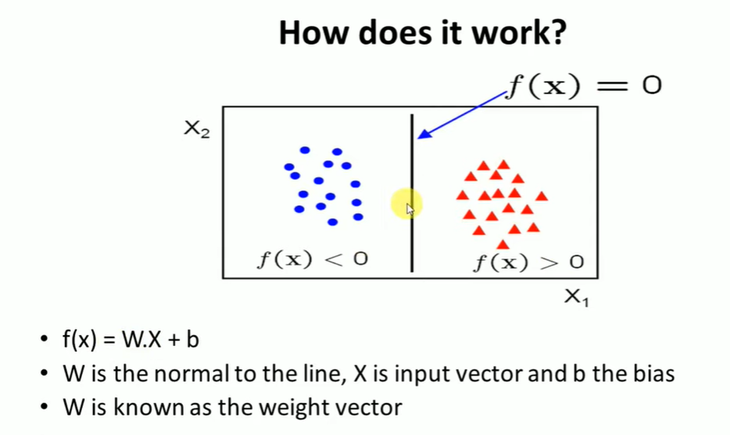
How Does Identify Right Hyperplane

Slide 24
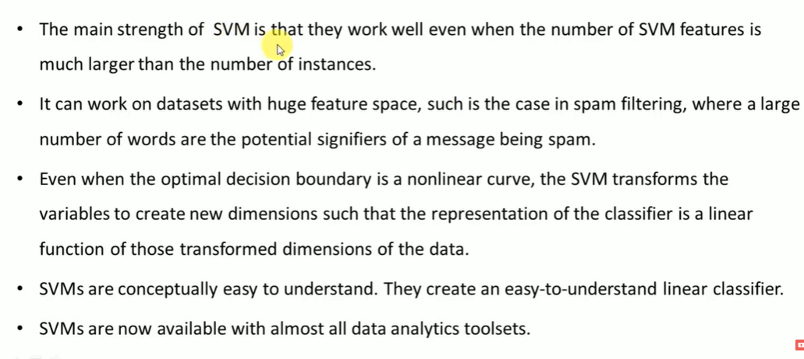
Advantages of SVM

Slide 25
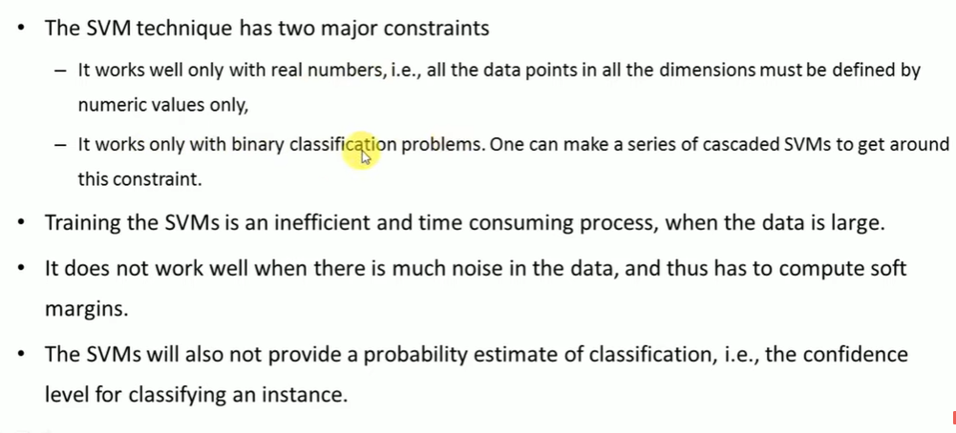
Disadvantages of SVM

Slide 26
How Does Identify Right Hyperplane
Scenario-4 Below we are not able to segregate the two classes using straight line, as one of the star lies on the territory of circle.
One star at other end is like an outlier for star class. The svm algorithm has the feature of ignoring the outlier and find the Hyperplane with maximum margins. Hence we can say that the svm classification is robust to outliers.

Slide 27
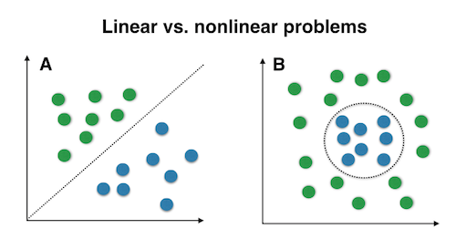
Non-Linear SVM
It is a form of data structure where the data elements don't stay arranged linearly or sequentially. Since the data structure is non-linear, it does not involve a single level.

Slide 28
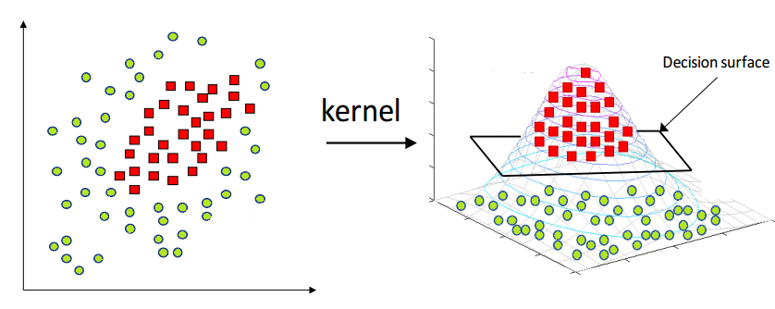
Kernel Function
In machine learning, a kernel refers to a method that allows us to apply linear classifiers to non-linear problems by mapping non-linear data into a higher-dimensional space without the need to visit or understand that higher-dimensional space.

Slide 29
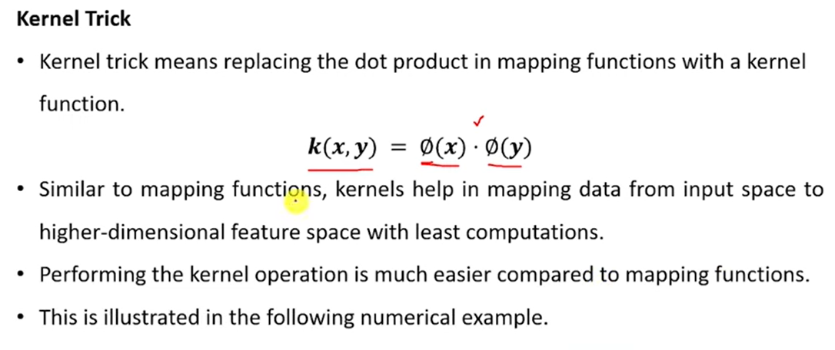
Kernel Trick

Slide 30
Types of Kernel Function
Polynomial Kernel
RBF Kernel
Sigmoid Kernel

Slide 31
Polynomial Kernel
The polynomial kernel is a kernel function commonly used with support vector machines and other kernelized models, that represents the similarity of vectors in a feature space over polynomials of the original variables
It is popular in image processing.
Where d is the degree of polynomial.
T is the transpose.

Slide 32
Radial-Basis Kernel Function
It is general purpose kernel: used when their is no prior knowledge about the data.

Slide 33
Hyperbolic Tangent Kernel
Mainly used in neural networks.
Where k>0 and c<0

Slide 34
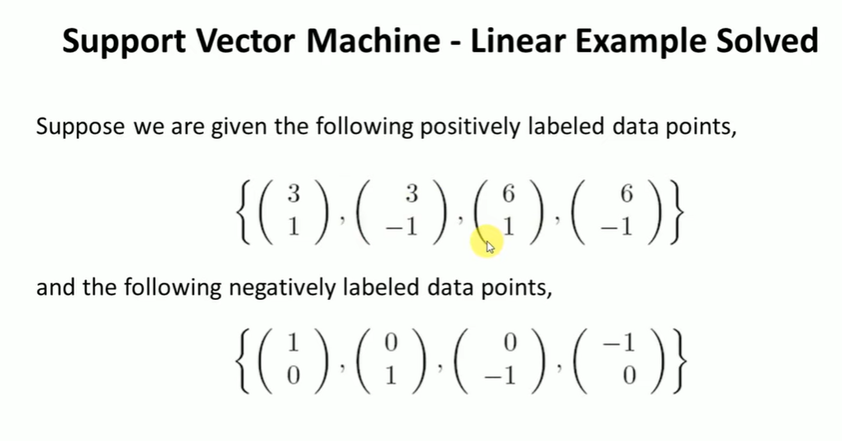
SVM Solved Numerical

Slide 35
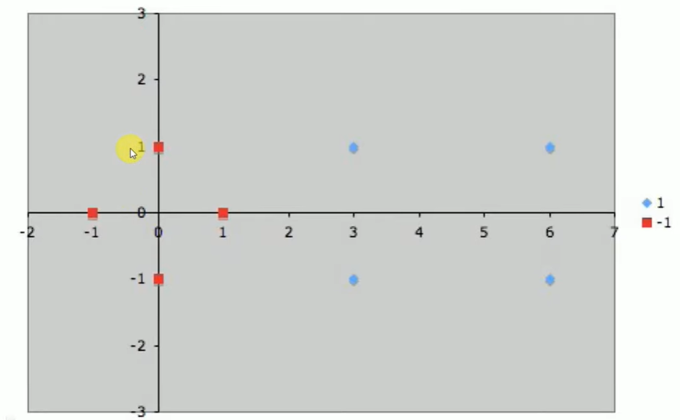
SVM Solved Numerical

Slide 36
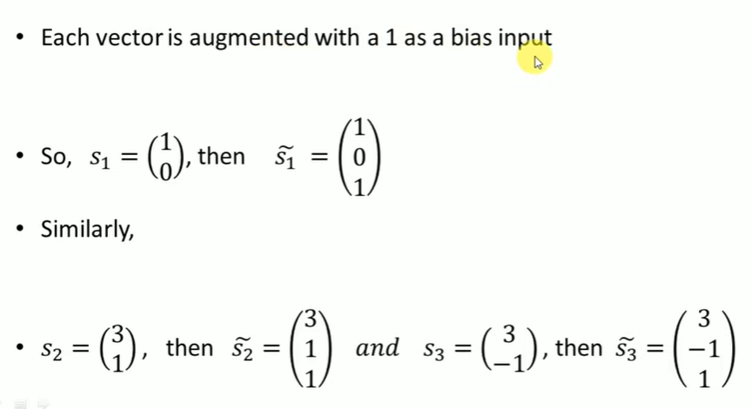
SVM Solved Numerical

Slide 37
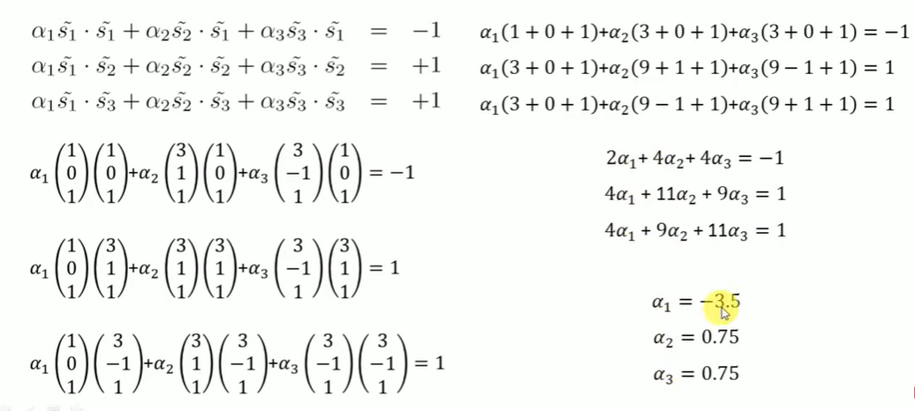
SVM Solved Numerical

Slide 38
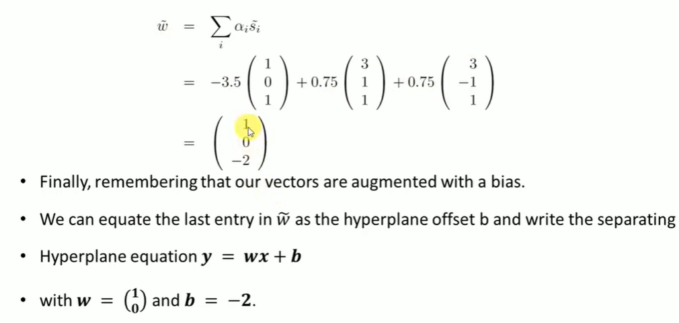
SVM Solved Numerical

Slide 39
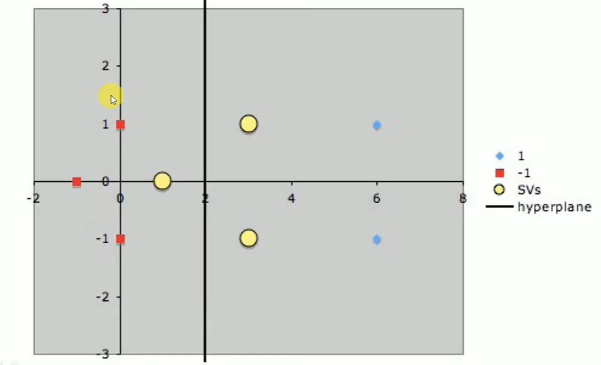
SVM Solved Numerical

